Slide 1
The Path of Moving Charges

Slide 2
Path of a Charge in a Constant Magnetic Field
What path will a charge take when it enters a constant magnetic field with a velocity v as shown below?
x x x x x x
x x x x x x
x x x x x x
x x x x x x
F_{c}
+
v
Since the force is always perpendicular to the v and B, the particle will travel in a circle
Hence, the force is a centripetal force.

Slide 3
Radius of Circular Path
What is the radius of the circular path?
x x x x x x
x x x x x x
x x x x x x
x x x x x x
Lorentz Force: $F=qv×B$
Centripetal Acc: $ac=\frac{v2}{R}$
Newton’s Second Law: $F=mac$
$$qvB=\frac{mv2}{R}$$
R
F_{c}
v
+
$$R=\frac{mv}{qB}$$

Slide 4
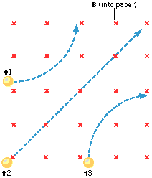
Right Hand Rule – What is the Charge?
Particle 1:
Positive
Negative
Neutral
Particle 2:
Positive
Negative
Neutral
Particle 3:
Positive
Negative
Neutral

Slide 5
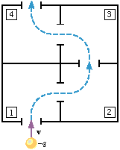
Right Hand Rule – What is the Direction of B
What is the direction of the magnetic field in each chamber?
Up
Down
Left
Right
Into Page
Out of Page
1
4
2
3
What is the speed of the particle when it leaves chamber 4?
v/2 b. -v
v d. 2v
Since the magnetic force is always perpendicular to the velocity, it cannot do any work and change its KE.

Slide 6
Example #2
A particle with a charge of $5.0×{10}^{−6} C$traveling at $7.5×105 m/s$enters a uniform magnetic field perpendicular to the lines of force. The particle then began to move in a circular path 0.30 meters in diameter due to a net force of $1.5×{10}^{−10}N$. What is the mass of the particle?

Slide 7
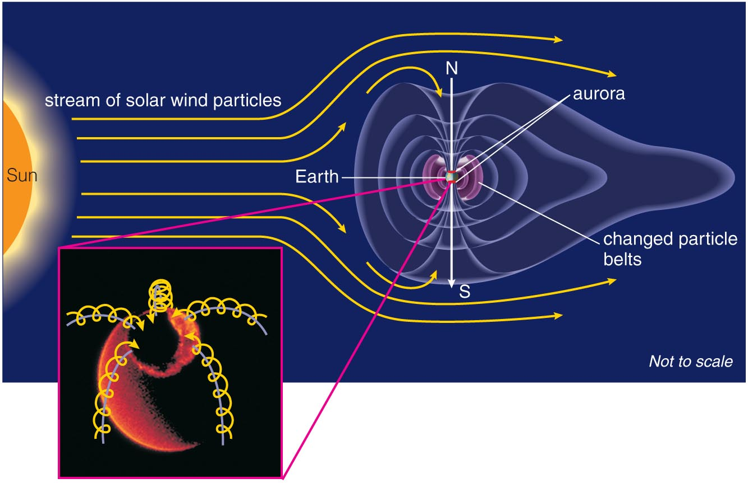
Earth’s Magnetosphere
Magnetic field of Earth’s atmosphere protects us from charged particles streaming from Sun (solar wind)

Slide 8
Aurora Borealis
Charged particles can enter atmosphere at magnetic poles, causing an aurora

Slide 9
Crossed Fields in the CRT
How do we make a charged particle go straight if the magnetic field is going to make it go in circles?
Use a velocity selector that incorporates the use of electric and magnetic fields.
Applications for a velocity selector:
Cathode ray tubes (TV, Computer monitor)

Slide 10
Crossed Fields
x x x x
x x x x
x x x x
+ + + + +
F_{E}
-
v
-
v
-
v
F_{B}
E
B into page
- - - - -
E and B fields are balanced to control the trajectory of the charged particle.
F_{B} = F_{E}
Velocity Selector
qvB = qE
v = E/B
Phosphor Coated Screen

Slide 11
Key Ideas
The Lorentz Force is a centripetal force.
Charged particles moving perpendicular to a magnetic field will travel in a circular path.
The magnetic force does not change the kinetic energy of a moving charged particle – only direction.
The Solar Wind consists of Cosmic radiation (subatomic charged particles) that travel near the speed of light.

